Slide 1

Learning Objective
I will interpret scatter plots
Enter quietly, please be ready with the following on your desk:
Whiteboard
Whiteboard marker
Exercise Book
Pencil, pen, ruler and red pen
Diary
Calculator
Device – charged or borrowed from Library before maths

Slide 2
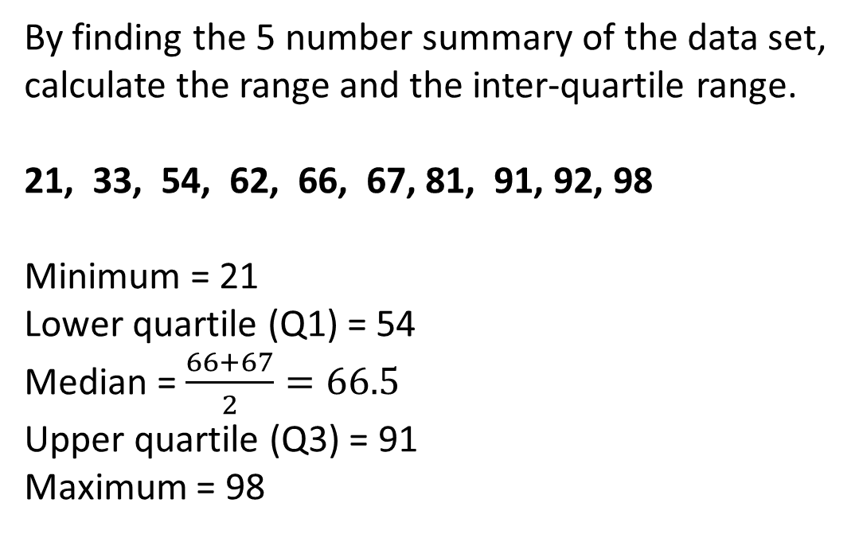
Daily Review
To find the median of a data set:
Step 1: Order the numbers from smallest to largest. Step 2: Find the middle number.
By finding the 5 number summary of the data set, calculate the range and the inter-quartile range.
21, 33, 54, 62, 66, 67, 81, 91, 92, 98
Minimum = 21
Lower quartile (Q1) = 54
Median = $\frac{66+67}{2}=66.5$
Upper quartile (Q3) = 91
Maximum = 98
To find the lower quartile of a data set:
Step 1: Underline the bottom half of the data set. Step 2: Find the middle number.
To find the upper quartile of a data set:
Step 1: Underline the top half of the data set. Step 2: Find the middle number.
If the median is one of the values, don’t include it in the lower/upper half.
If the median is between two values, include it in the lower/upper half.
Range (maximum – minimum):
98 – 21 = 77
Inter-quartile range (Q3 – Q1):
91 – 54 = 37

Slide 3
Daily Review
A Science student records the temperature at midday every day for a month.
Draw a boxplot of their data.
Minimum | 13
Q1 | 15
Median | 16
Q3 | 18.5
Maximum | 24

Slide 4
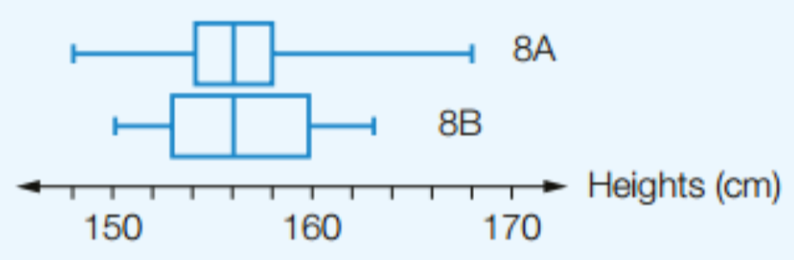
Daily Review
CFU 1
What three things do you need to compare in a boxplot?
8A
8B
8A
Minimum | 148
Q1 | 154
Median | 156
Q3 | 158
Maximum | 168
Minimum | 150
Q1 | 153
Median | 156
Q3 | 160
Maximum | 163
Range: 168 – 148 = 20
IQ range: 158 – 154 = 4
8B
Range: 163 – 150 = 13
IQ range: 160 – 153 = 7
Draw a parallel boxplot of the two class’ data.
Compare the median, range and inter-quartile range for each class.
The medians for the two classes are the same. The range for 8A is much larger than for 8B. However, the IQR for 8A is much smaller than the IQR for 8B.

Slide 5
Learning Objective
CFU 1
What will we learn?
I will interpret scatter plots.
CFU 2
What will we learn?
CFU 3
How will we know if we’ve been successful?
Success Criteria
CFU 4
How will we know if we’ve been successful?
I will be able to:
Identify types of correlation
Identify the dependent and independent variable
Interpret scatter plots

Slide 6
Activate Prior Knowledge
CFU 1
Give an example of primary and secondary data.
Primary data is data you collect yourself.
Secondary data is data that has already been collected.
Do the following examples represent primary data or secondary data?
You are doing a project on water storage, so you collect data from the newspaper on the levels of the dams in your state over the past year.
You survey youth in your area to find out what facilities they would like the council to provide.
You sit on your doorstep and record the colour of the cars passing by.
You write the scores for all the weekend’s AFL matches from an app.
Secondary data
Primary data
Primary data
Secondary data

Slide 7
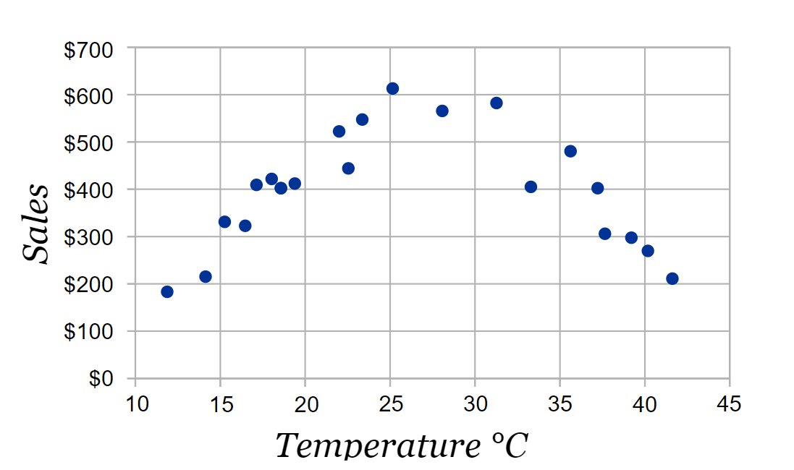
Concept Development
Bivariate data is data for two variables (usually two types of related data).
A scatter plot can be used to display bivariate data and show any connections that might exist between the variables.
A scatter plot uses the data to create a series of points drawn on a pair of axes, with each axis representing the values of one of the two variables.
The independent variable is plotted on the x axis and the dependent variable is plotted on the y axis.
This is a scatter plot showing data for temperature (°C) and ice cream sales.
Temperature is the independent variable.
Ice cream sales is the dependent variable.
VOCABULARY
Bivariate data – data for two variables

Slide 8
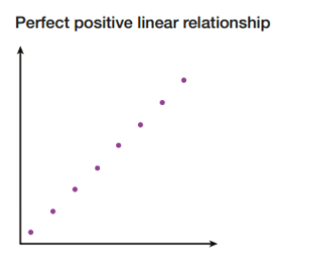
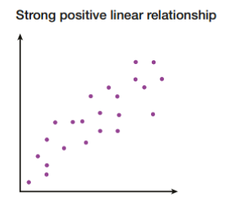
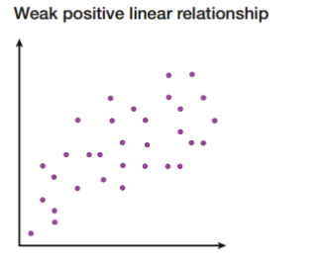
Concept Development
A scatter plot makes it easier to see any relationships that might exist between the variables you are looking at.
Sometimes, the points on the scatter plot will look as though they are almost forming a straight line.
If one variable increases as the other increases, the relationship is positive (we call this positive correlation).
If one variable increases as the other decreases, the relationship is negative (negative correlation).

Slide 9
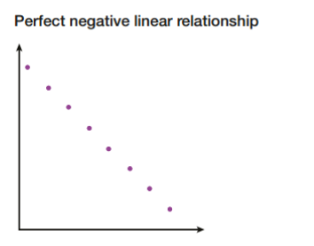
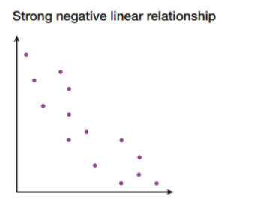
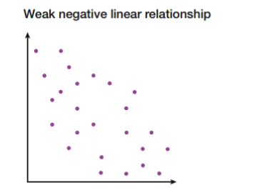
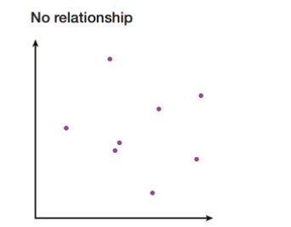
Concept Development
A scatter plot makes it easier to see any relationships that might exist between the variables you are looking at.
Sometimes, the points on the scatter plot will look as though they are almost forming a straight line.
If one variable increases as the other increases, the relationship is positive (we call this positive correlation).
If one variable increases as the other decreases, the relationship is negative (we call this negative correlation).

Slide 10
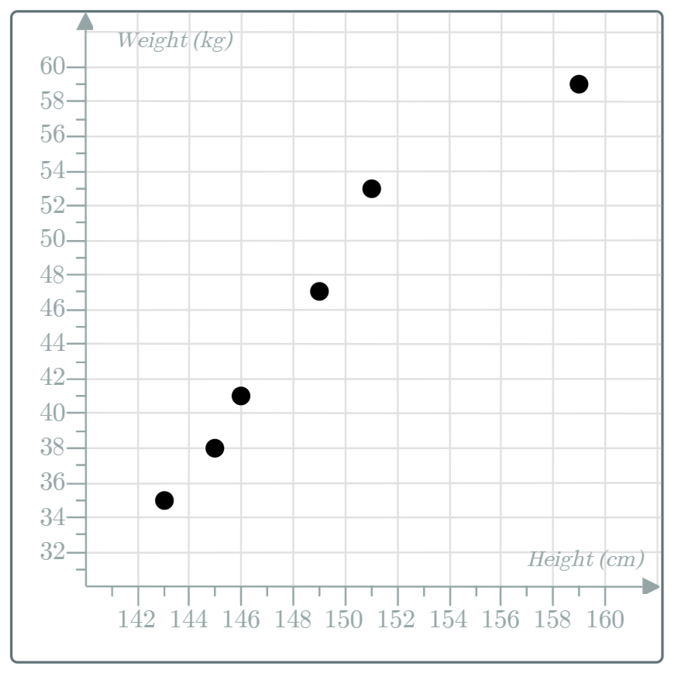
Skill Development
This scatter plot shows the height (cm) and weight (kg) of 6 students.
What kind of correlation does this scatter plot show?
Strong positive correlation.
How tall is the tallest student?
159 cm.
How heavy is the lightest student?
35 kg.

Slide 11
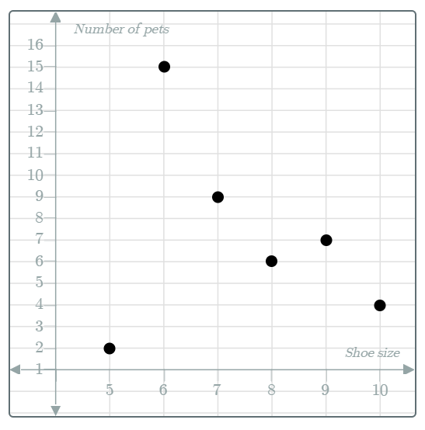
Skill Development
This scatter plot shows the number of pets and shoe size of 6 students.
What kind of correlation does this scatter plot show?
No correlation
One student wears size 6 shoes. How many pets do they have?
15 pets.
Jim has 7 pets. Bob has 4 pets. Who has bigger feet?
Bob.

Slide 12
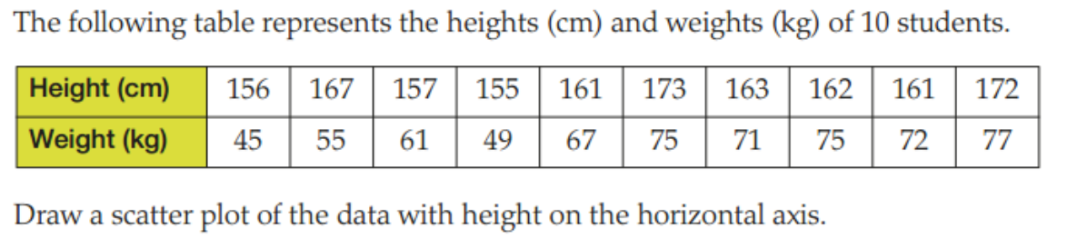
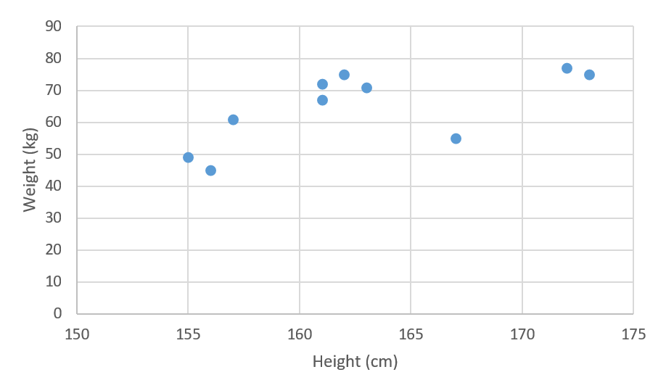
Guided Practice
What kind of correlation does this scatter plot show?
Positive correlation.

Slide 13
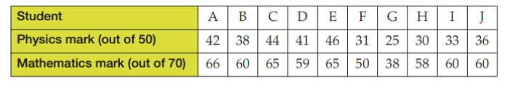
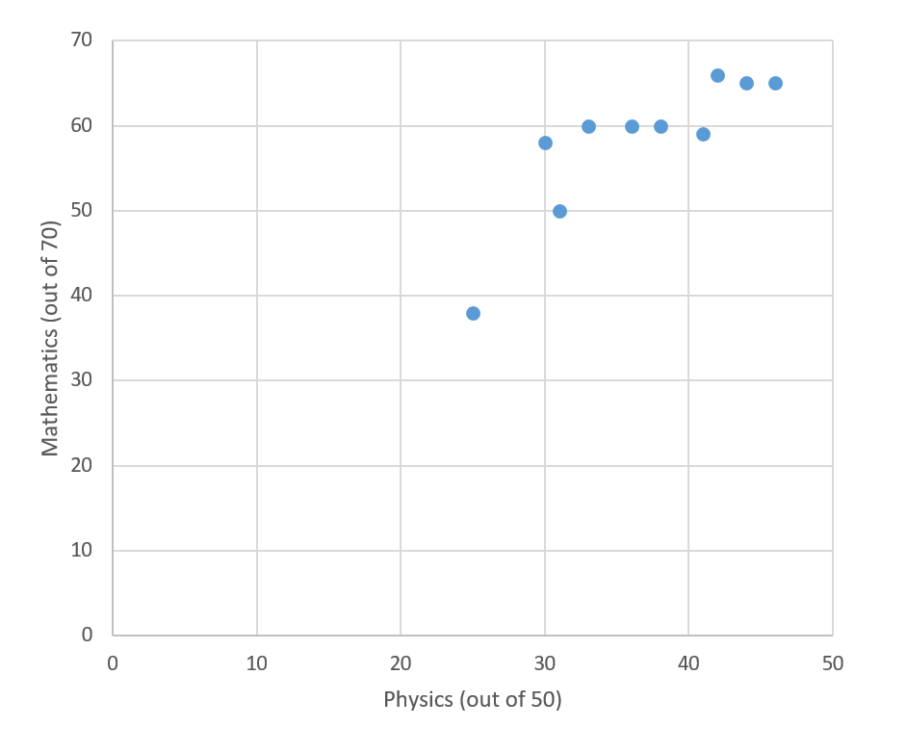
Guided Practice
What kind of correlation does this scatter plot show?
Positive correlation.

Slide 14
Independent Practice
Mathspace – Year 10 Mainstream Scatter Plots CLASSWORK

